Slide 1



TITLE :
KONGU ENGINEERING COLLEGE
(Autonomous)
DEPARTMENT OF COMPUTER TECHNOLOGY - UG
BATCH NO :06
Website For Rooster Restaurant
GUIDED BY: Dr.S.Poorani MPhil.,PhD.,
Team Members:
Dhanush S (22BSR006)
Krithik M S (22BSR028)
Moulidharan P(22BSR032)

Slide 2
Abstract
The project’s primary objective is to create a method for clients to make reservations for restaurants online.
The project aims to implement a restaurant idea that helps people to save time. People prefer quick methods to get things done.
Through this website the customer can pre-order products online before going to the restaurant and, Book a table for upcoming events, it also shows offers in the restaurant dynamically.
HTML, CSS and React.js are used for Front-end design, Node.js and MongoDB are used for Back-end development

Slide 3
Problem Statement
►Running a restaurant is a complex and challenging task. Restaurant owners and managers must not only focus on providing delicious food but also ensure the smooth running of all operations.
► Today, Restaurant waiter takes the customer ordering by manual system with using paper. Restaurant management system puts the order in a queue with specific priority according to time and quantity.
► We will explore challenging problems in restaurant management and their solutions. By understanding and addressing these issues.

Slide 4
Solution
►Customers can book tables online, view real-time availability and select their preferred date, time, and table.
►The system provide an interface for reservations and automatically send confirmation to the customers.
►The system should allow customers to place orders in advance through an online platform.

Slide 5
Modules:
Login
Admin control access
User control access
Menu
Event
Take Away
Home Delivery
Table Booking

Slide 6
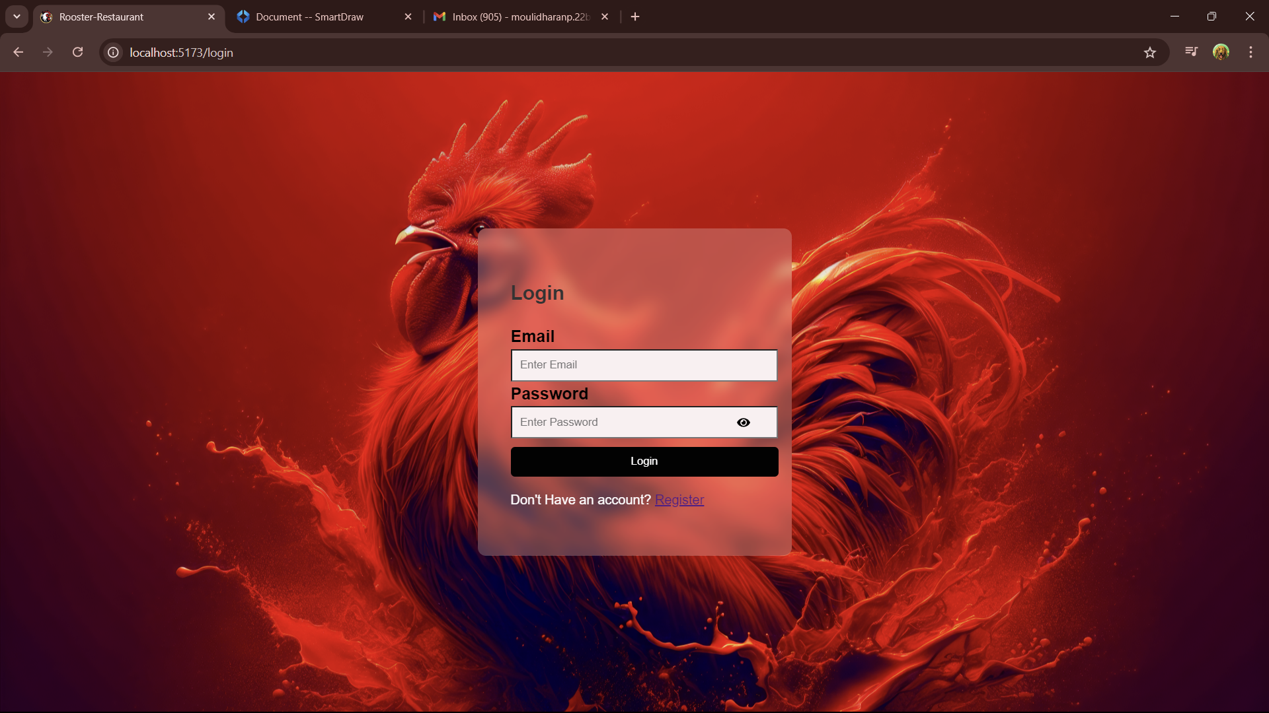
LogIn

Slide 7
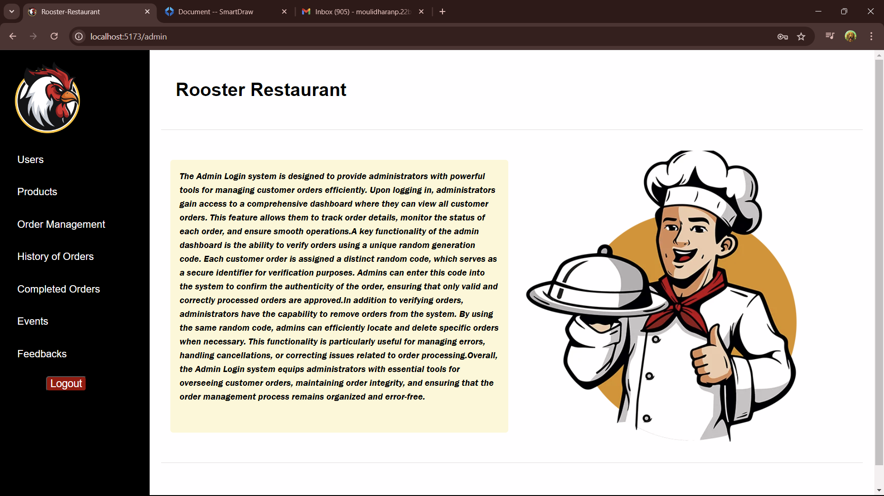
Admin Interface

Slide 8
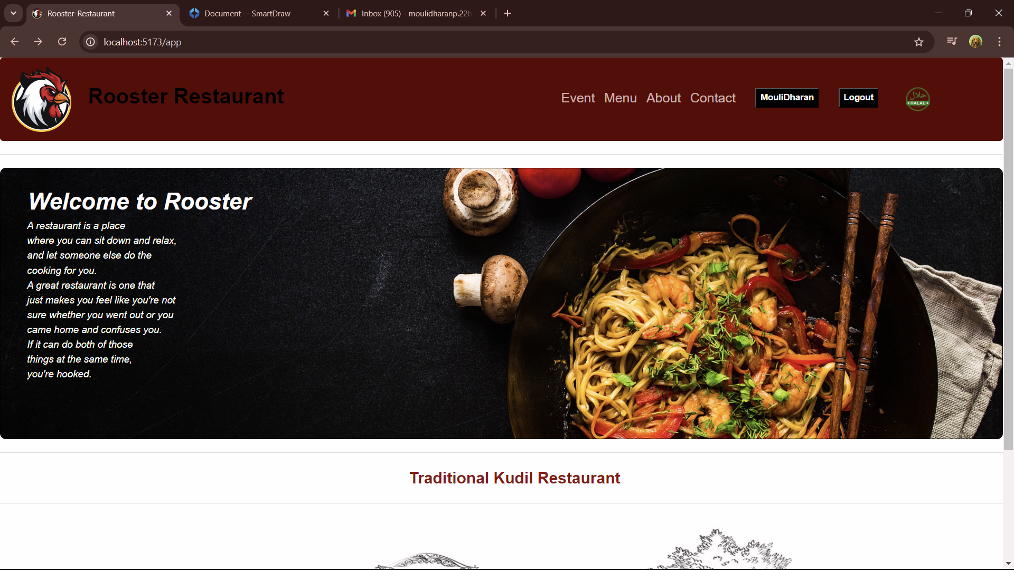
User Interface

Slide 9
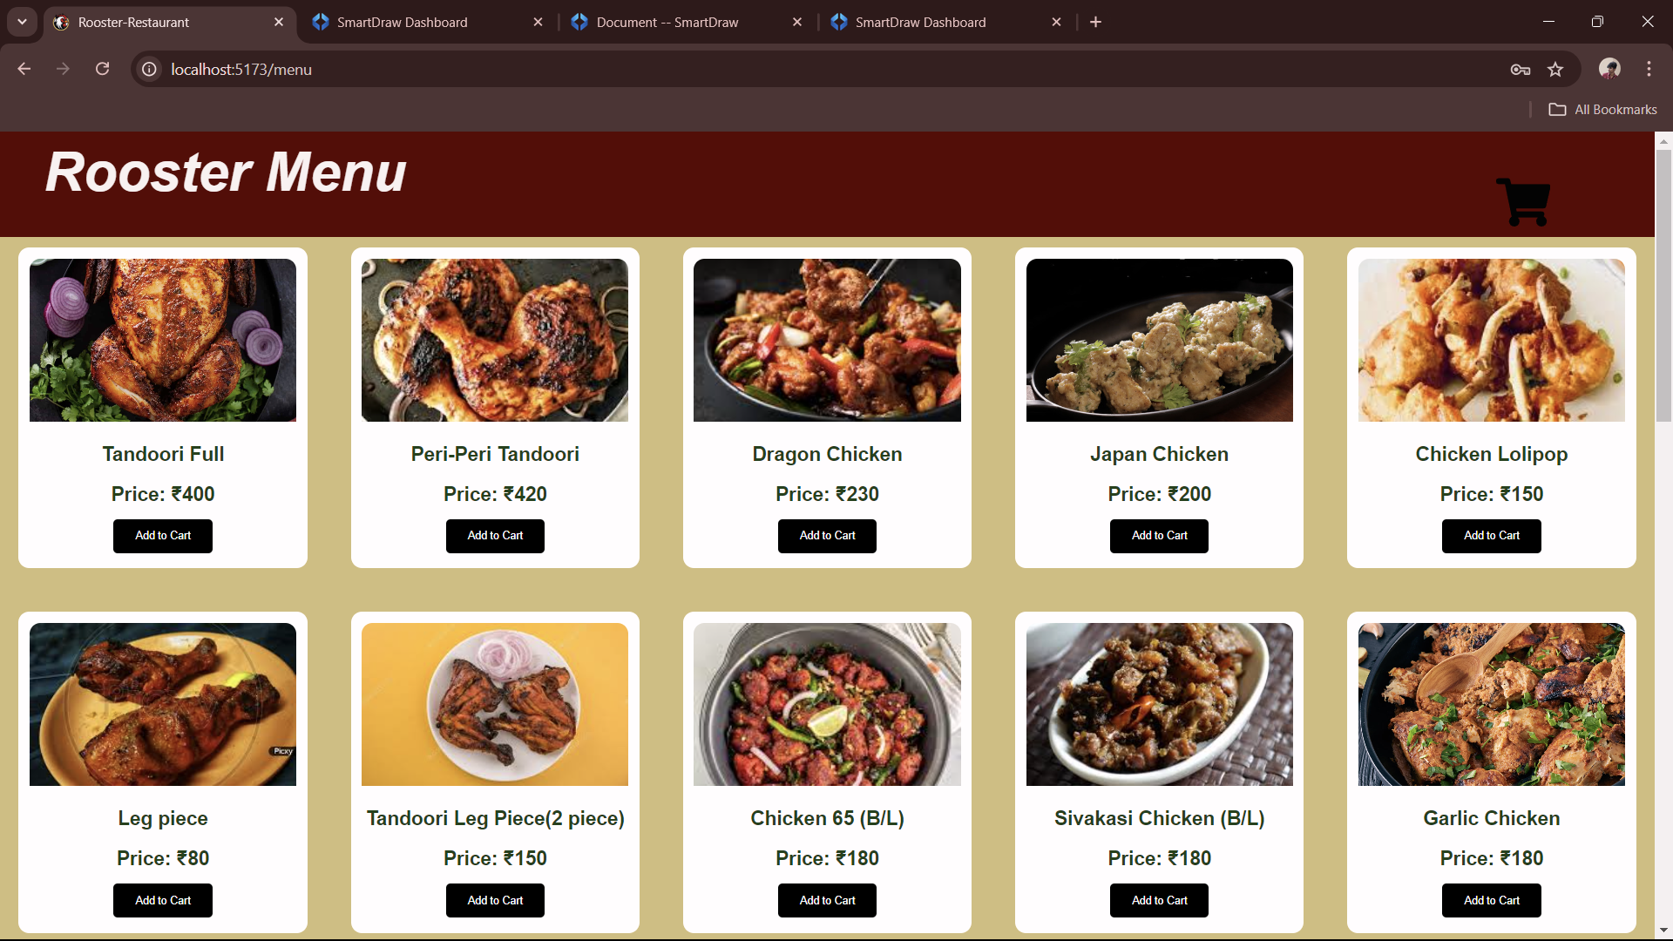
Menu

Slide 10
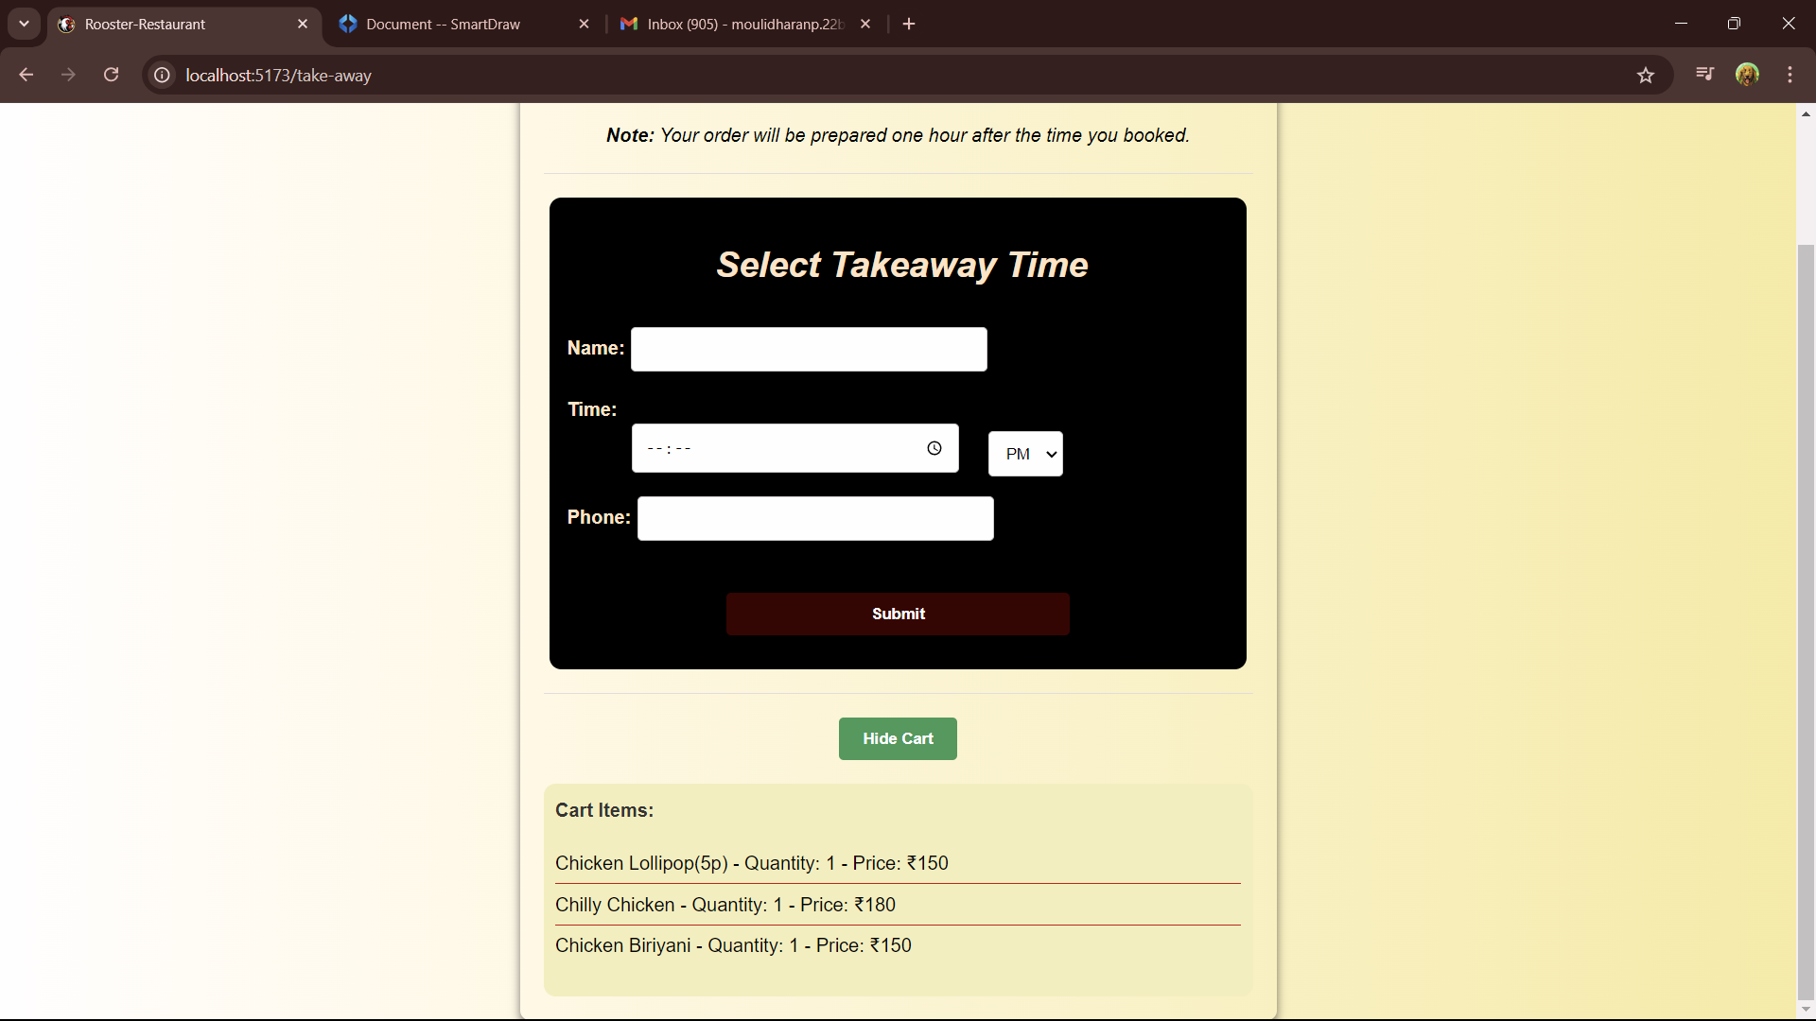
Take Away

Slide 11
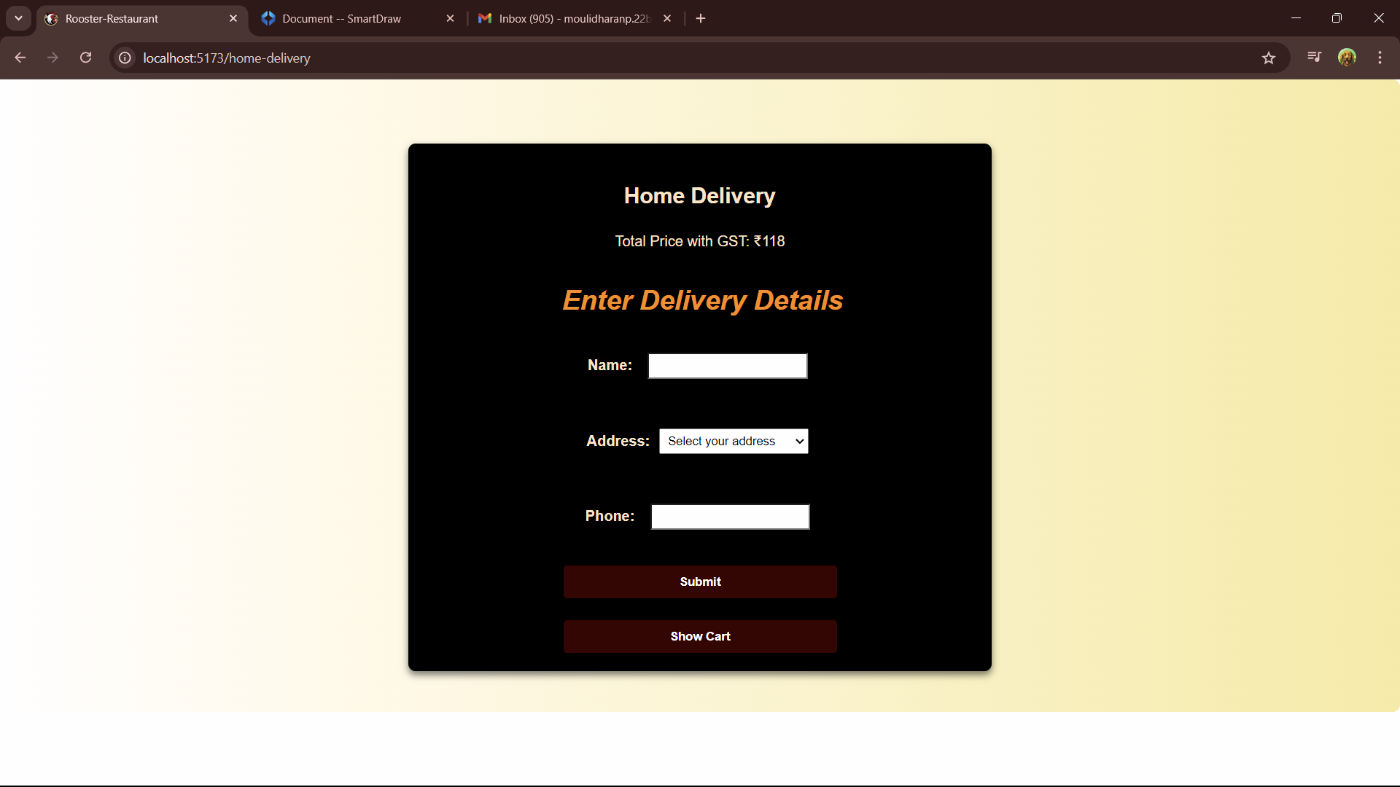
Home Delivery

Slide 12
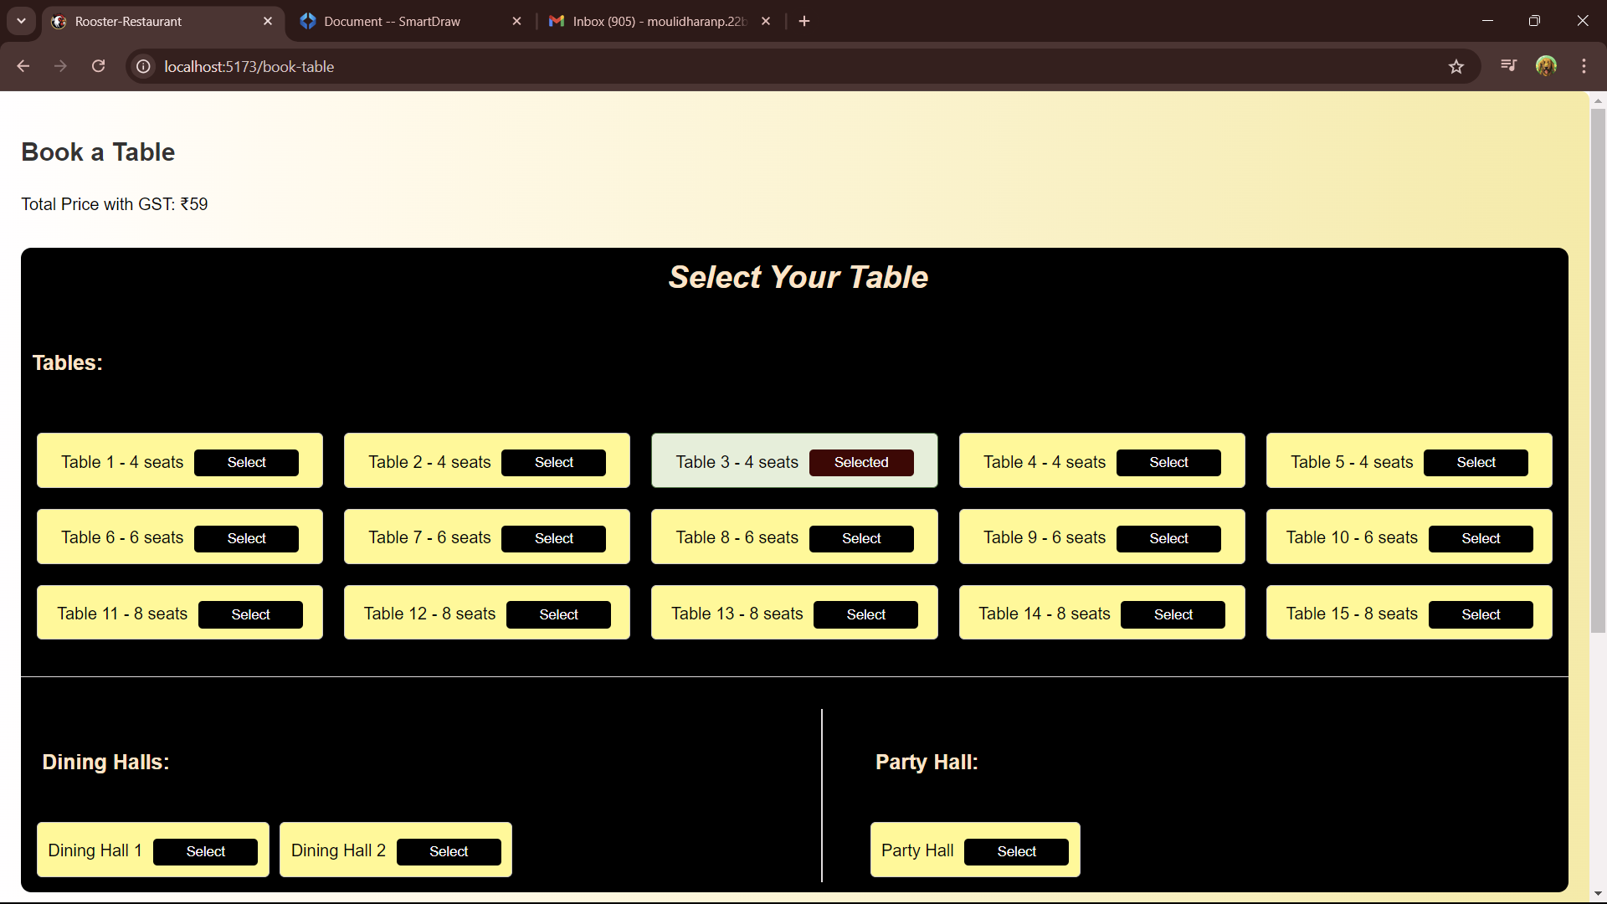
Table Booking

Slide 13
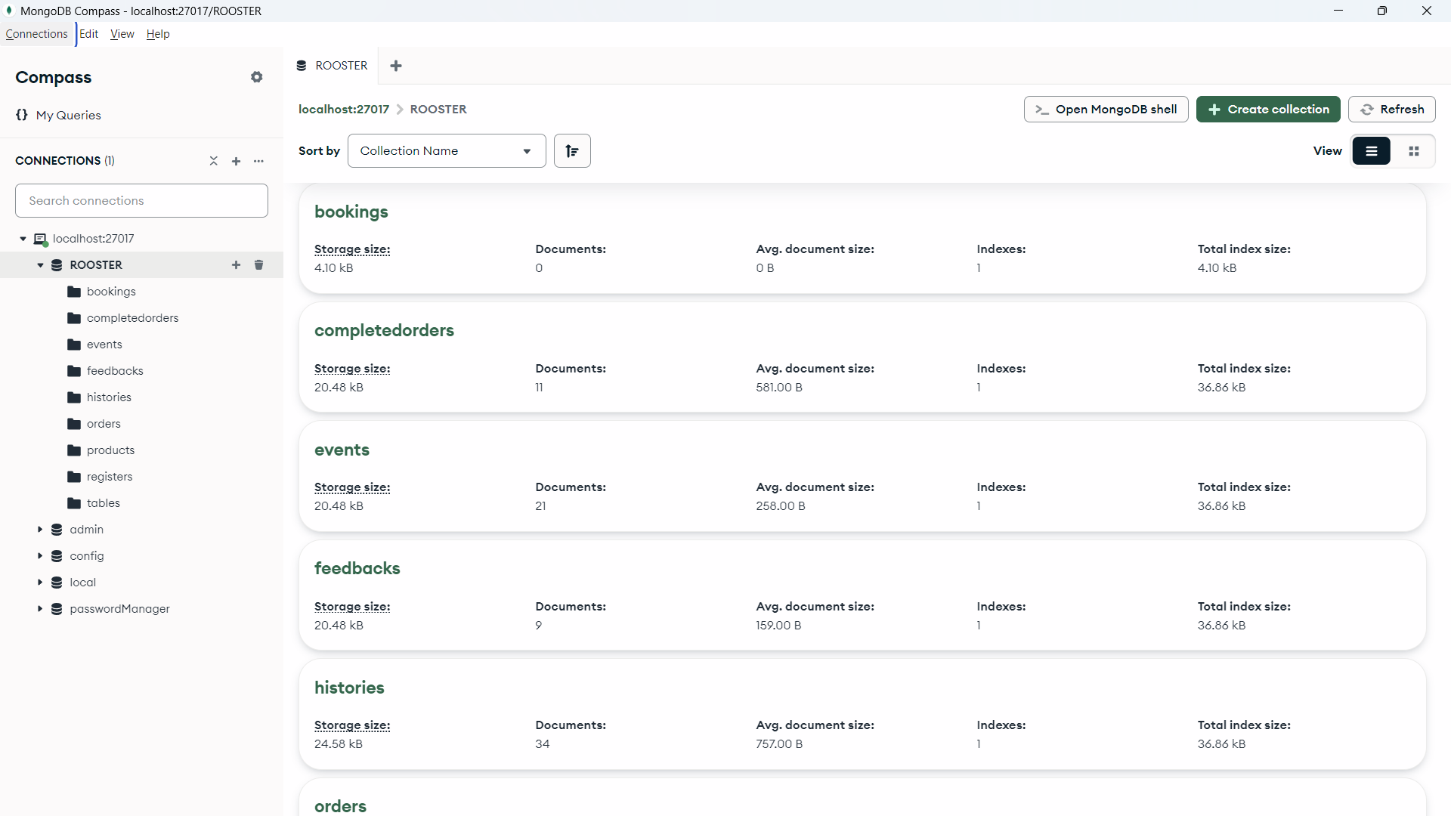
Database Design

Slide 14
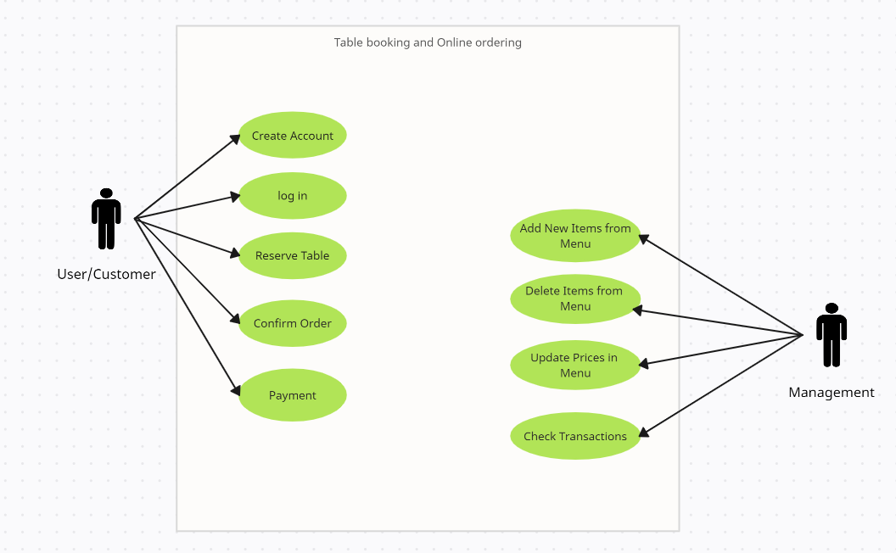
Use case Diagram

Slide 15
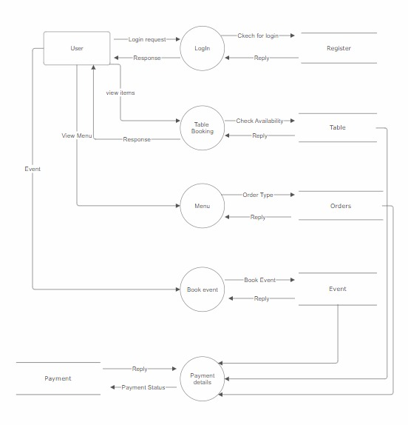
Data Flow Diagram

Slide 16
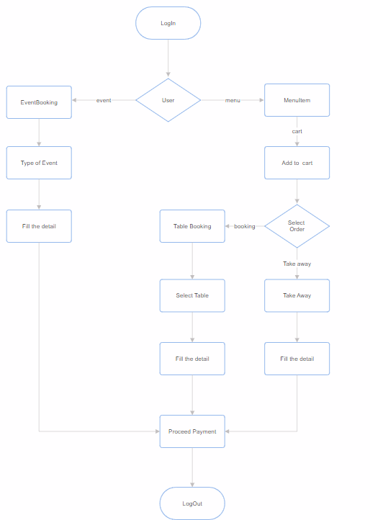
System Flow Diagram

Slide 17
Thank You

